Slide 1



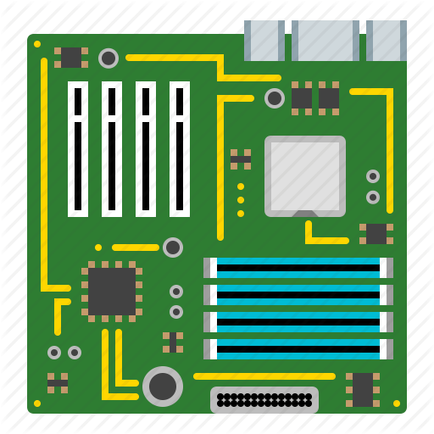
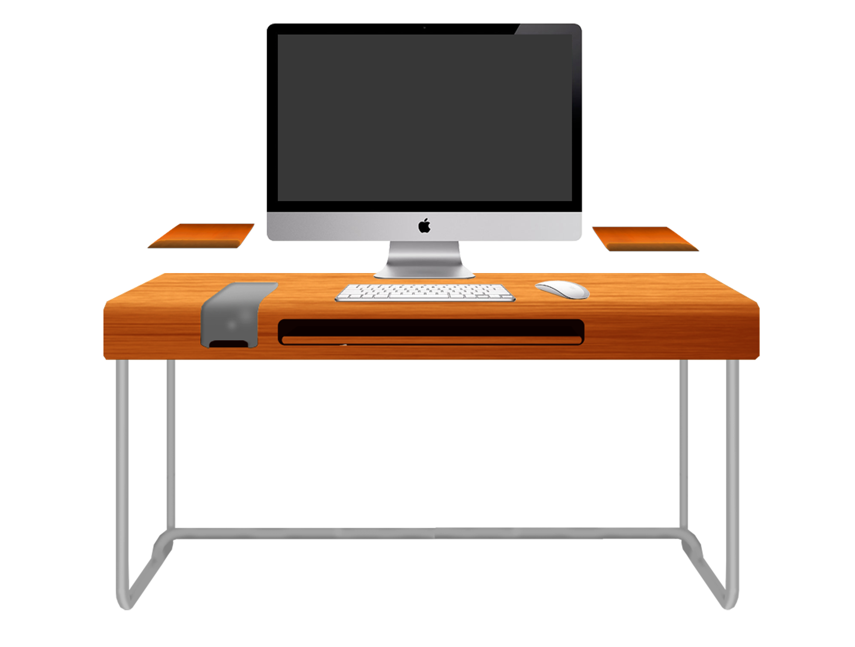


Computer cost builder
Easily Compare your builds
Jakob Beck

